Slide 1
Thank You
This PowerPoint document contains the images that you requested.
Copyright Notice
All materials on this Site are protected by United States copyright law and may not be reproduced, distributed, transmitted, displayed, or otherwise published without the prior written permission of Wolters Kluwer. You may not alter or remove any trademark, copyright or other notice.
However, provided that you maintain all copyright, trademark and other notices contained therein, you may download material (one machine readable copy and one print copy per page) for your personal, non-commercial use only. Please refer to this link for further information on how to
apply for permission for re-use
Any information posted to discussion forums (moderated and un-moderated) is for informational purposes only. We are not responsible for the information or the result of its practice.

Slide 2
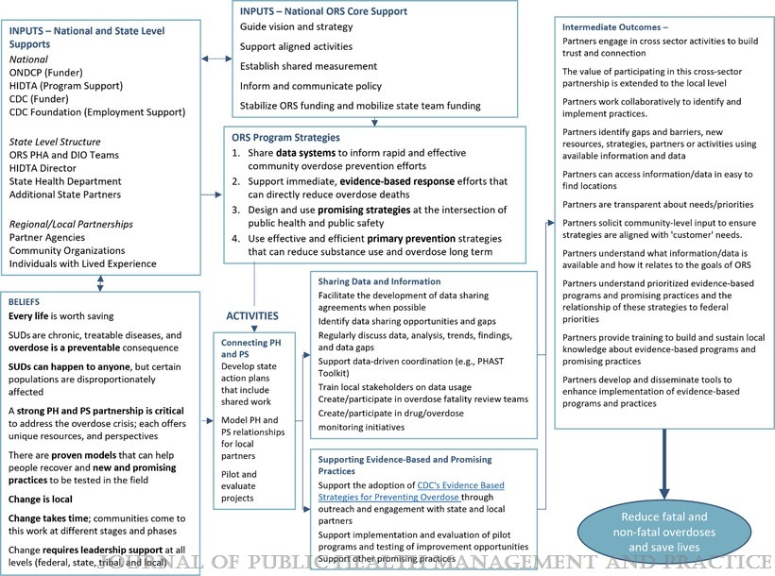
FIGURE
The Overdose Response Strategy: Reducing Drug Overdose Deaths Through Strategic Partnership Between Public Health and Public Safety
Wolff, Jessica; Gitukui, Stephanie; O'Brien, Mallory; Mital, Sasha; Noonan, Rita K.
Journal of Public Health Management and Practice28(Supplement 6):S359-S366, November/December 2022.
doi: 10.1097/PHH.0000000000001580
ORS Logic ModelAbbreviations: CDC, Centers for Disease Control and Prevention; DIO, Drug Intelligence Officer; HIDTA, High-Intensity Drug Trafficking Area; ONDCP, Office of National Drug Control Policy; ORS, Overdose Response Strategy; PH, public health; PHA, public health analyst; PHAST, Public Health and Safety Teams Toolkit; PS, public safetyThis figure is available in color online (www.JPHMP.com).

